Slide 1
Project 1
Description : Project on Data Analysis of wikipedia / dump wikimedia data
Done By :
Raju Rana

Slide 2
Question 1
Which English wikipedia article got the most traffic on Jan 20, 2021?

Slide 3
CREATE TABLE pageview (
domain_code STRING,
page_title STRING,
count_views int,
total_response_size int)
ROW FORMAT DELIMITED
FIELDS TERMINATED BY ' '
TBLPROPERTIES("skip.header.line.count"="0");
CREATE TABLE pageview_table (
domain_code STRING,
page_title STRING,
count_views int,
total_response_size int)
ROW FORMAT DELIMITED
FIELDS TERMINATED BY ' '
TBLPROPERTIES("skip.header.line.count"="0");
create view pgview as
select page_title, SUM(count_views) as count_views from pageview_table
GROUP by page_title
sort by count_views DESC;
INSERT into pageview_table
select * from pageview where domain_code = 'en';
SELECT page_title , count_views *24 FROM pgview limit 1;
Result :
Main_Page 1964472
LOAD DATA LOCAL INPATH '/home/raju/projects/mydata/pageviews-20210120-000000' INTO TABLE pageview;

Slide 4
Question 2
What English wikipedia article has the largest fraction of its readers follow an internal link to another wikipedia article?

Slide 5
CREATE TABLE clickstream(
`referrer` string,
`resource` string,
`type` string,
`occurance` int)
ROW FORMAT delimited
FIELDS TERMINATED BY '\t'
TBLPROPERTIES ('skip.header.line.count'='0');
LOAD DATA LOCAL INPATH '/home/raju/clickstream-enwiki-2020-12.tsv' INTO TABLE clickstream;
create view v1 as
select resource, sum(occurance) as occr
from clickstream
group by resource;
create view v2 as
select resource , SUM(occurance) as ocr
from clickstream
where type ='link'
group by resource ;
SELECT v1.resource, ocr/occr as fraction
from v1 join v2
on v1.resource = v2.resource
order by fraction DESC
limit 1;
Result :
"Steeplejack"_Charles_Miller 1.0

Slide 6
Question 3
What series of wikipedia articles, starting with Hotel California, keeps the largest fraction of its readers clicking on internal links? This is similar to (2), but you should continue the analysis past the first article. There are multiple ways you can count this fraction, be careful to be clear about the method you find most appropriate.

Slide 7
Query
create view v31 as
select resource, sum(occurance) as occur
FROM clickstream
group by resource
order by occur desc;
CREATE view v32 as
select referrer , resource , occurance
from clickstream
where referrer = 'Hotel_California' AND `type` = 'link'
order by occurance DESC
limit 1;
CREATE view v33 as
select cs.referrer, cs.resource , cs.occurance as occurance
from clickstream as cs
where referrer in (select b.resource from v32 as b) AND `type` = 'link'
order by occurance desc
limit 1;
CREATE table seriesTable(resource1 string,
total_views1 bigint, resource2 string,
occurance2 bigint, resource3 string,
occurance3 bigint)
ROW FORMAT DELIMITED
FIELDS TERMINATED BY ' '
TBLPROPERTIES("skip.header.line.count"="0");

Slide 8
INSERT into seriestable
SELECT a.resource as resource1 , a.occur AS total_views1, b.resource AS resource2 , b.occurance AS occurance2, c.resource as resource3 , c.occurance as occurance3 from v31 AS a join v32 as b on a.resource = b.referrer join v33 as c on b.resource=c.referrer order by occurance2, occurance3 desc;
SELECT resource1 , total_views1, resource2 ,occurance2,resource3 , occurance3 , (occurance2/total_views1)*(occurance3/occur)*1 as fraction from seriesTable join v31 on v31.resource = seriesTable.resource2;

Slide 9
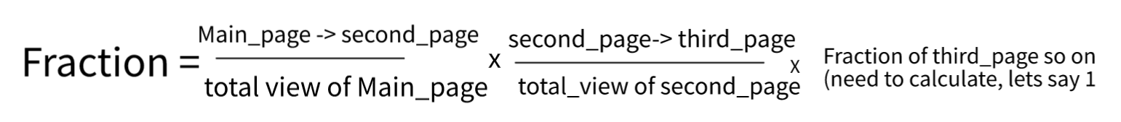
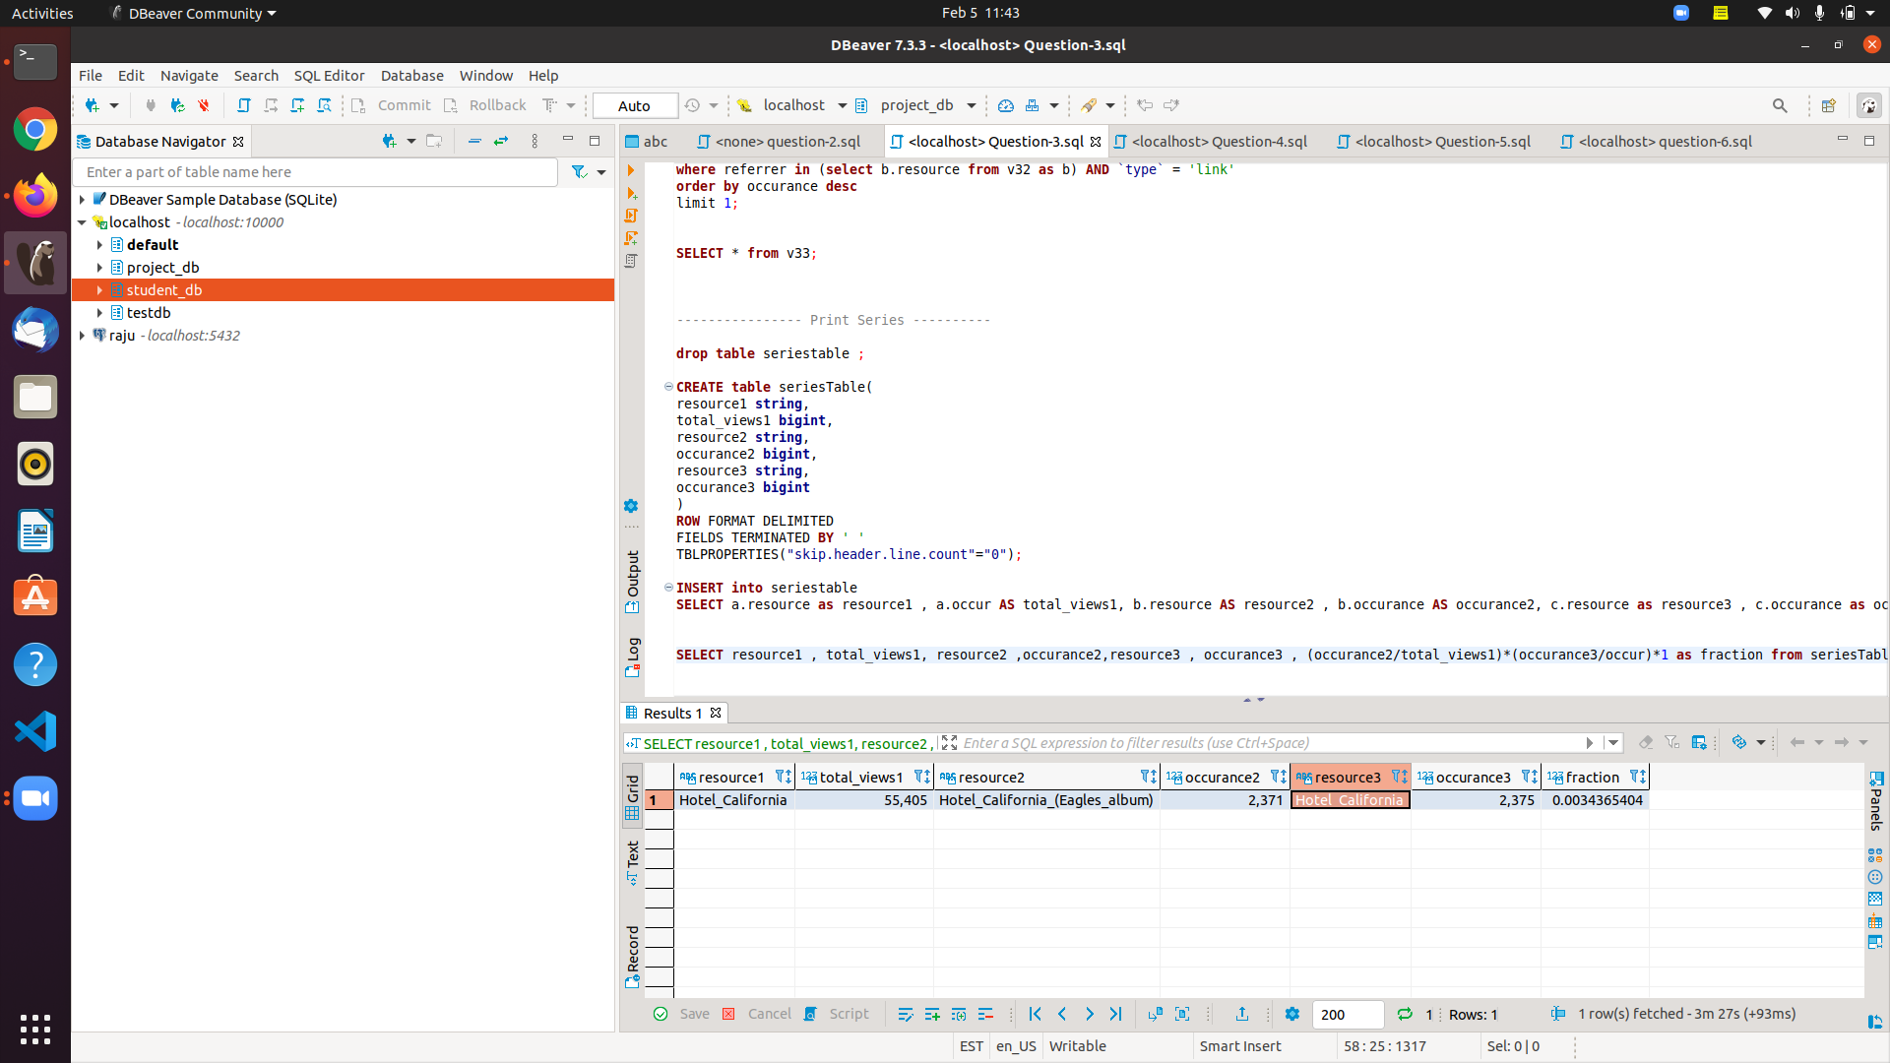

Slide 10
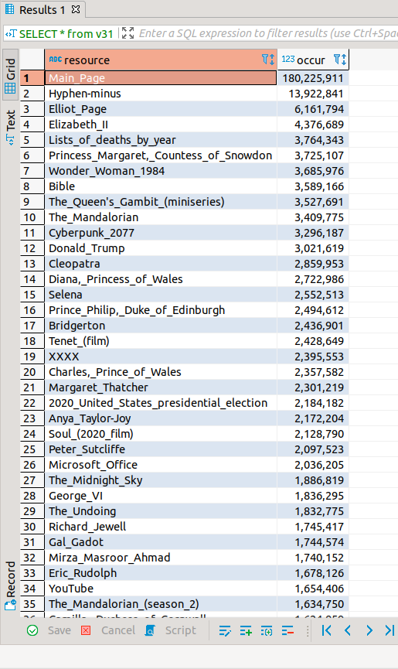
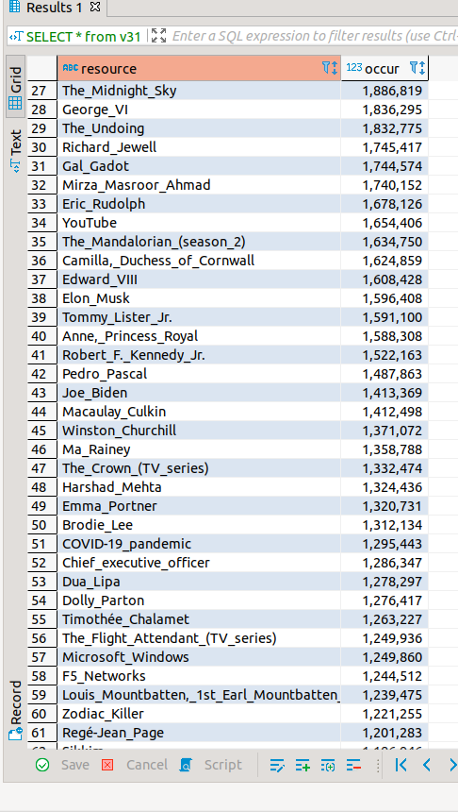
Result : total page view, including internal, external others

Slide 11
Question 4
Find an example of an English wikipedia article that is relatively more popular in the Americas than elsewhere. There is no location data associated with the wikipedia pageviews data, but there are timestamps. You'll need to make some assumptions about internet usage over the hours of the day.

Slide 12
CREATE TABLE pageview (
domain_code STRING,
page_title STRING,
count_views int,
total_response_size int)
ROW FORMAT DELIMITED
FIELDS TERMINATED BY ' '
TBLPROPERTIES("skip.header.line.count"="0");
CREATE TABLE pageview_table (
domain_code STRING,
page_title STRING,
count_views int,
total_response_size int)
ROW FORMAT DELIMITED
FIELDS TERMINATED BY ' '
TBLPROPERTIES("skip.header.line.count"="0");
INSERT into pageview_table
select * from pageview where domain_code = 'en';
LOAD DATA LOCAL INPATH '/home/raju/projects/mydata/pageviews-20210120-000000' INTO TABLE pageview;

Slide 13
CREATE TABLE apageview (
domain_code STRING,
page_title STRING,
count_views int,
total_response_size int)
ROW FORMAT DELIMITED
FIELDS TERMINATED BY ' '
TBLPROPERTIES("skip.header.line.count"="0");
CREATE TABLE apageview_table (
domain_code STRING,
page_title STRING,
count_views int,
total_response_size int)
ROW FORMAT DELIMITED
FIELDS TERMINATED BY ' '
TBLPROPERTIES("skip.header.line.count"="0");
INSERT into apageview_table
select * from apageview where domain_code = 'en';
LOAD DATA LOCAL INPATH '/home/raju/projects/mydata/pageviews-20210120-120000' INTO TABLE pageview;

Slide 14
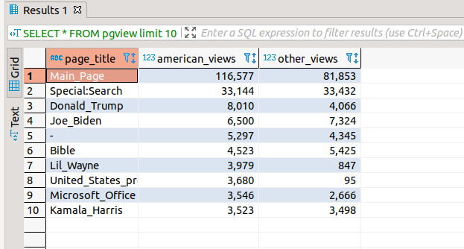
create view pgview as
select page_title, SUM(apageview_table.count_views) as american_views, SUM(pageview_table.count_views) other_views
from pageview_table join apageview_table
on pageview_table.page_title = apageview_table.page_title
GROUP by pageview_table.page_title
sort by american_views DESC;
SELECT * FROM pgview limit 10;

Slide 15
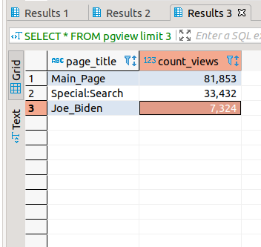
Result :

Slide 16
Question 5:
Analyze how many users will see the average vandalized wikipedia page before the offending edit is reversed.

Slide 17
CREATE TABLE revision_wiki (
wiki_db STRING,
event_entity STRING,
event_type STRING,
event_timestamp STRING,
event_comment STRING,
event_user_id INT,
event_user_text_historical STRING,
event_user_text STRING,
event_user_blocks_historical STRING,
event_user_blocks STRING,
event_user_groups_historical STRING,
event_user_groups STRING,
event_user_is_bot_by_historical STRING,
event_user_is_bot_by STRING,
event_user_is_created_by_self BOOLEAN,
event_user_is_created_by_system BOOLEAN,
event_user_is_created_by_peer BOOLEAN,
event_user_is_anonymous BOOLEAN,
event_user_registration_timestamp STRING,
event_user_creation_timestamp STRING,
event_user_first_edit_timestamp STRING,
event_user_revision_count INT,
event_user_seconds_since_previous_revision INT,
page_id INT,
page_title_historical STRING,
page_title STRING,
page_namespace_historical INT,
page_namespace_is_content_historical BOOLEAN,
page_namespace INT,
page_namespace_is_content BOOLEAN,
page_is_redirect BOOLEAN,
page_is_deleted BOOLEAN,
page_creation_timestamp STRING,
page_first_edit_timestamp STRING,
page_revision_count INT,
page_seconds_since_previous_revision INT,
user_id INT,
user_text_historical string,
user_text string,
user_blocks_historical string,
user_blocks string,
user_groups_historical string,
user_groups string,
user_is_bot_by_historical string,
user_is_bot_by string,
user_is_created_by_self boolean,
user_is_created_by_system boolean,
user_is_created_by_peer boolean, user_is_anonymous boolean,
user_registration_timestamp string,
user_creation_timestamp string,
user_first_edit_timestamp string,
revision_id INT,
revision_parent_id INT,
revision_minor_edit boolean,
revision_deleted_parts string,
revision_deleted_parts_are_suppressed boolean,
revision_text_bytes INT,
revision_text_bytes_diff INT,
revision_text_sha1 string,
revision_content_model string,
revision_content_format string,
revision_is_deleted_by_page_deletion boolean,
revision_deleted_by_page_deletion_timestamp string,
revision_is_identity_reverted boolean,
revision_first_identity_reverting_revision_id INT,
revision_seconds_to_identity_revert INT,
revision_is_identity_revert boolean,
revision_is_from_before_page_creation boolean,
revision_tags string)
ROW FORMAT DELIMITED
FIELDS TERMINATED BY '\t';

Slide 18
LOAD DATA LOCAL INPATH '/home/raju/projects/mydata/2020-12.enwiki.2020-12.tsv' INTO TABLE revision_wiki ;
SELECT page_title, revision_seconds_to_identity_revert
FROM revision_wiki
where event_entity ="revision" and revision_is_identity_reverted =true
order by revision_seconds_to_identity_revert ;

Slide 19
CREATE view vendaliseTimeTable as
SELECT AVG(revision_seconds_to_identity_revert) as average_time
FROM revision_wiki
where event_entity ="revision" and revision_is_identity_reverted =true;
SELECT * from vendaliseTimeTable;
create view userView as
SELECT AVG(count_views) as average_view from pageview_table;
SELECT * from userview ;
average_vendalise_user = average_view * average_time / 3600;average_vendalise_user = average_view * average_time / 3600;

Slide 20
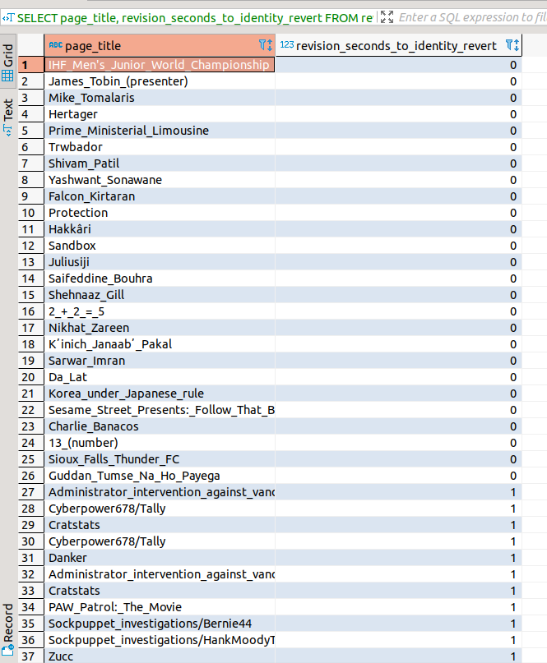
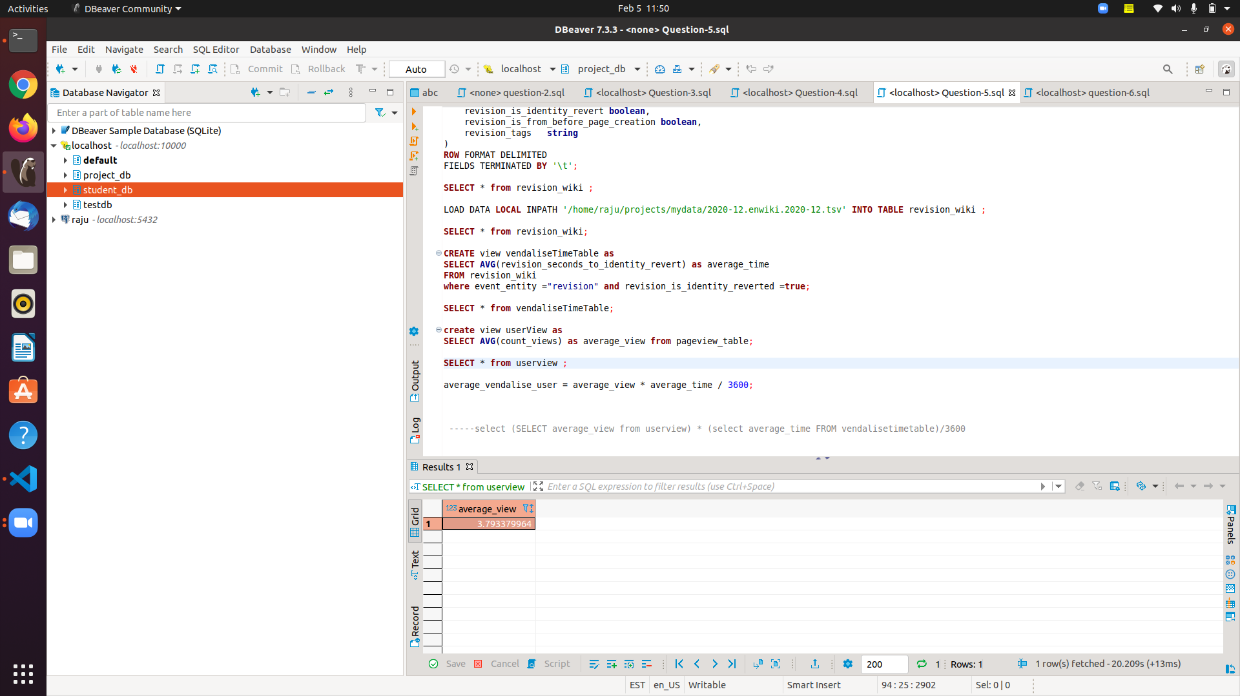

output
Fraction = 3.793379964*110579.0322/3600
= 116.518

Slide 21
Question 6: Run an analysis you find interesting on the wikipedia datasets we're using.
Find english dead end pages that is pages that either don't have any link on it or has non-relavant links on them so that user never visit any pages from that page.

Slide 22
Queries
CREATE TABLE clickstream(
`referrer` string,
`resource` string,
`type` string,
`occurance` int)
ROW FORMAT delimited
FIELDS TERMINATED BY '\t'
TBLPROPERTIES ('skip.header.line.count'='0');
CREATE TABLE clickstream2(
`referrer` string,
`resource` string,
`type` string,
`occurance` int)
ROW FORMAT delimited
FIELDS TERMINATED BY '\t'
TBLPROPERTIES ('skip.header.line.count'='0');
CREATE TABLE clickstream3(
`referrer` string,
`resource` string,
`type` string,
`occurance` int)
ROW FORMAT delimited
FIELDS TERMINATED BY '\t'
TBLPROPERTIES ('skip.header.line.count'='0');
LOAD DATA LOCAL INPATH '/home/raju/clickstream-enwiki-2020-12.tsv' INTO TABLE clickstream;
LOAD DATA LOCAL INPATH '/home/raju/clickstream-enwiki-2020-12.tsv' INTO TABLE clickstream2;

Slide 23
insert into clickstream3
SELECT referrer , resource , type , occurance from clickstream where resource in (SELECT b.referrer from clickstream2 b order by b.referrer ASC) ;
SELECT referrer , resource , `type` , occurance clickstream2
except
SELECT referrer , resource , `type` , occurance clickstream3

Slide 24
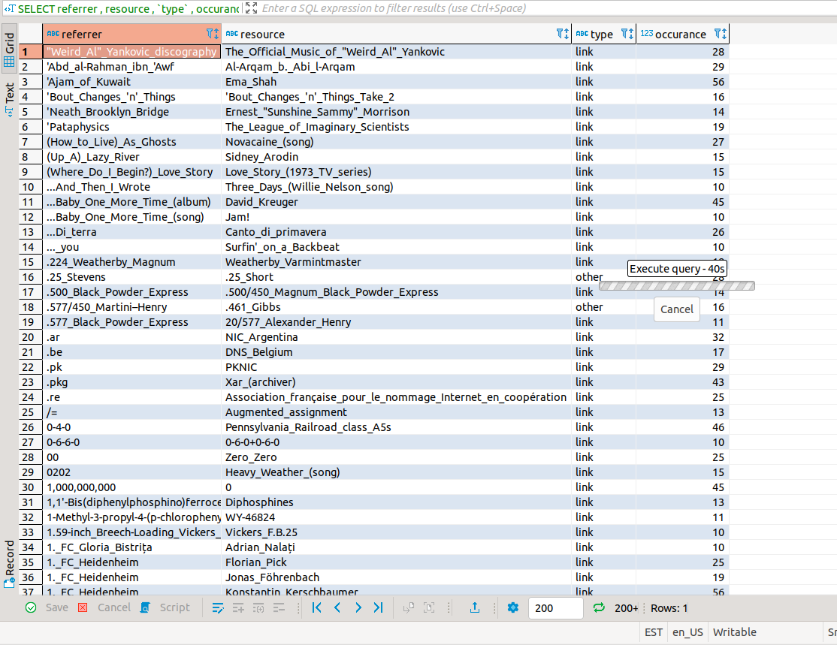

Slide 25
Git hub Repo
https://github.com/rajurana20/poroject1

